Slide 1
Site C Deep Dive

Slide 2
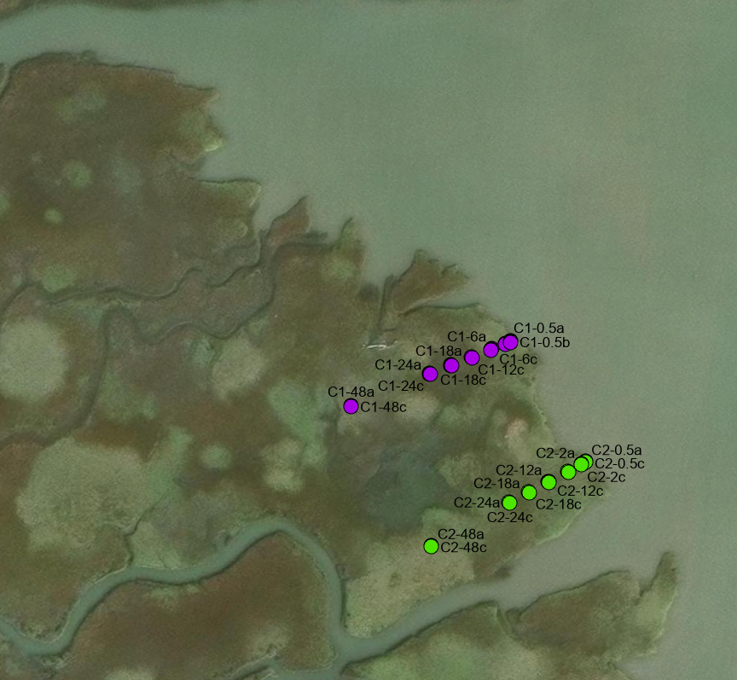
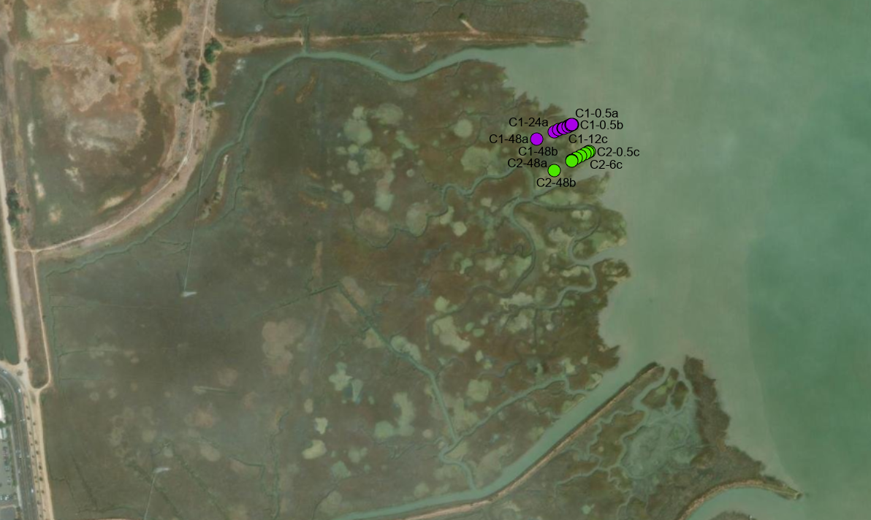
Site C Position Within the Bay
Notes:
Why did you choose these transect locations (can generally for each site will have to do this) especially for this site how uneven marsh edge is from each other, orientation direction and reasoning. For z*, go through the elevation process (what are the control points, etc.) look for the error in the elevation measurements especially for the sites like this where there’s not too much differences Show the elevation data first (for each site-include locations for control points, include the tidal datum locations, then move to z* and only refer z*)

Slide 3
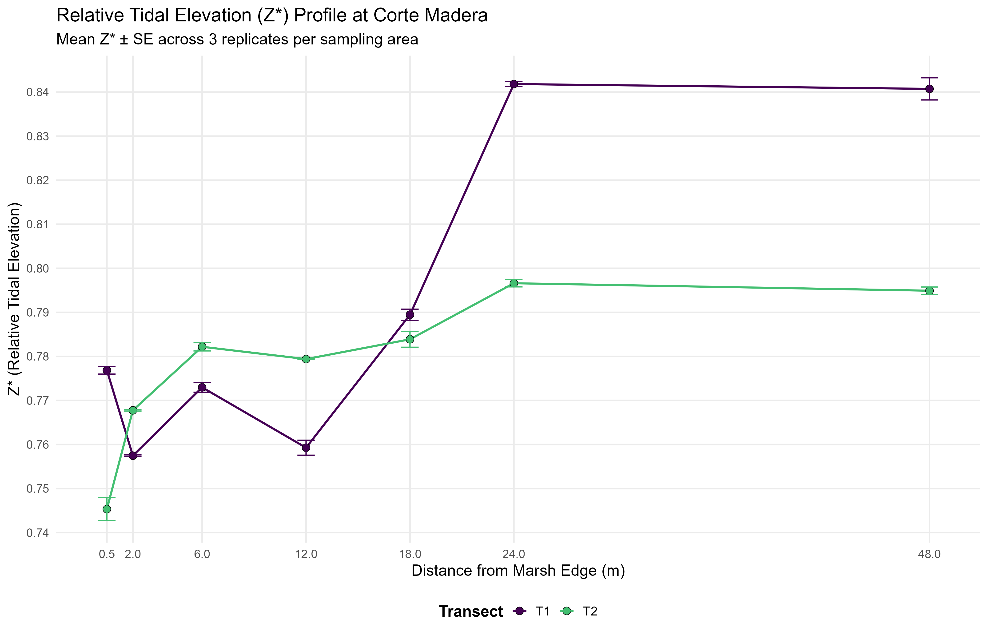

z* star Relative Elevation Versus Elevation (m) of Marsh Edge Profile
Notes:
Interesting that they’re different. Can lead with the calculation of z* introduction from the beginning, introduce that z* is for understanding the flooding component across the marsh; using the same tidal datum dataframe set to uniform it.

Slide 4
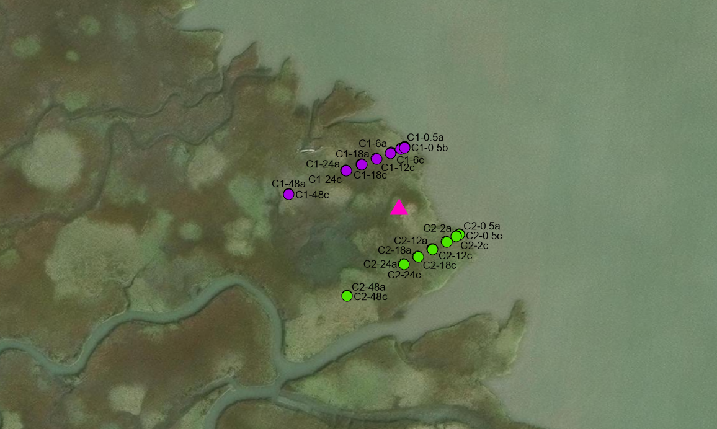
z* star calculation:
Step 1: Median Center of the “site C” layer points
(see pink triangle)

Slide 5
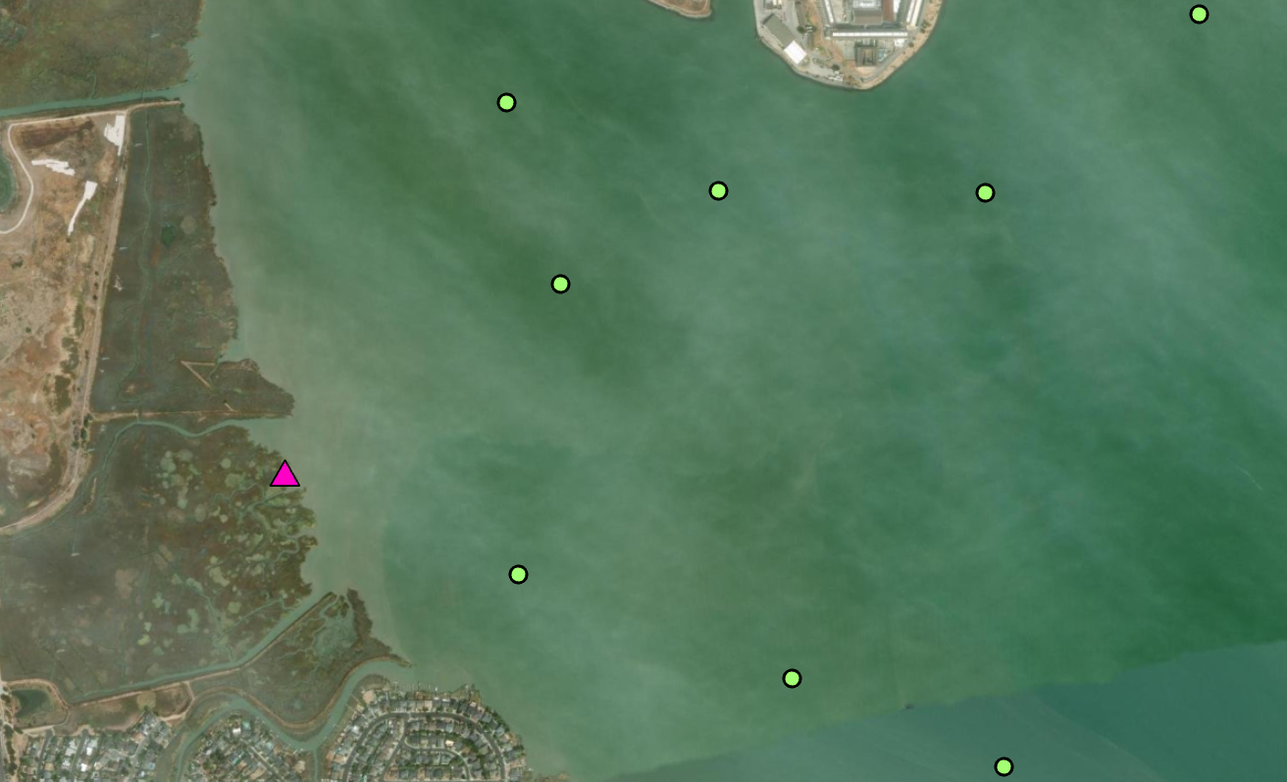
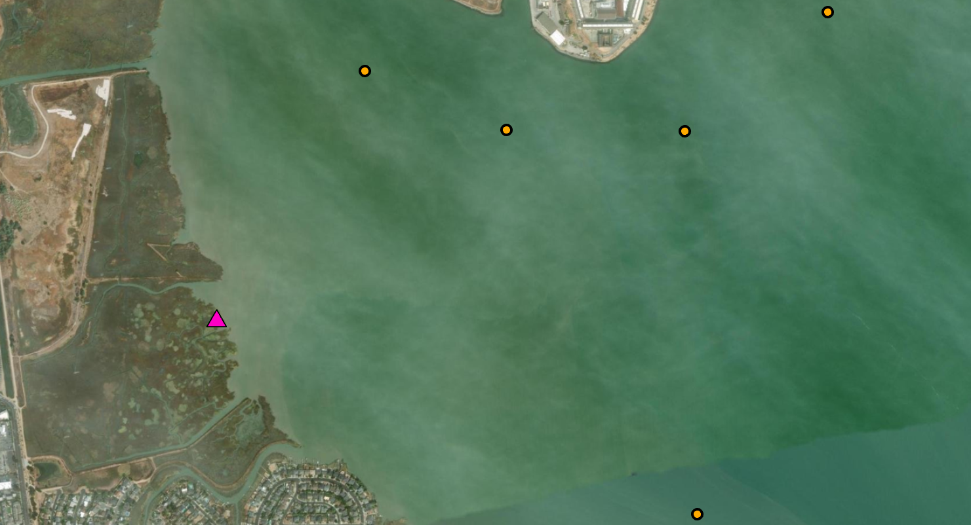
Z* star calculation: Step 2: Sort by Attribute within the SF BCDC 2016 Tidal Datums for any values that don’t have “null” or “-9999” in MSL
Notes:
All this detail likely not needed for the walk through; broad awareness of the choice-differences in bathymetry between the sites

Slide 6
Z* star calculation: Step 3: Use “Near” Geoprocessing Tool with the new Median Center Site C layer to find the nearest Tidal Datum station that is sorted for MSL Levels
Site | X Midpoint Coordinate | Y Midpoint Coordinate | Nearest Distance (meters) | Nearest Station ID | MSL (ft) | MHHW (ft)
C | 5983823.271 | 2167114.728 | 3080.398912 | 335 | 3.319648 | 6.069566

Slide 7
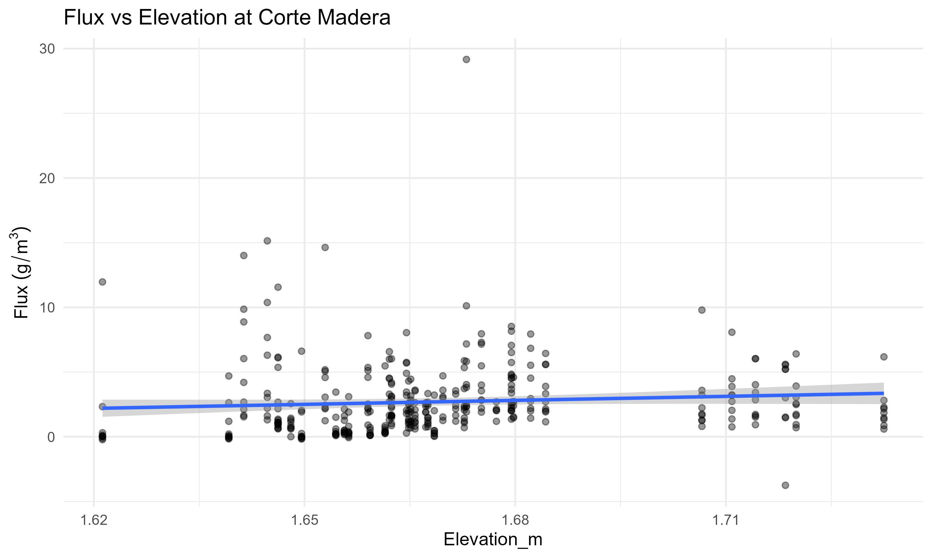
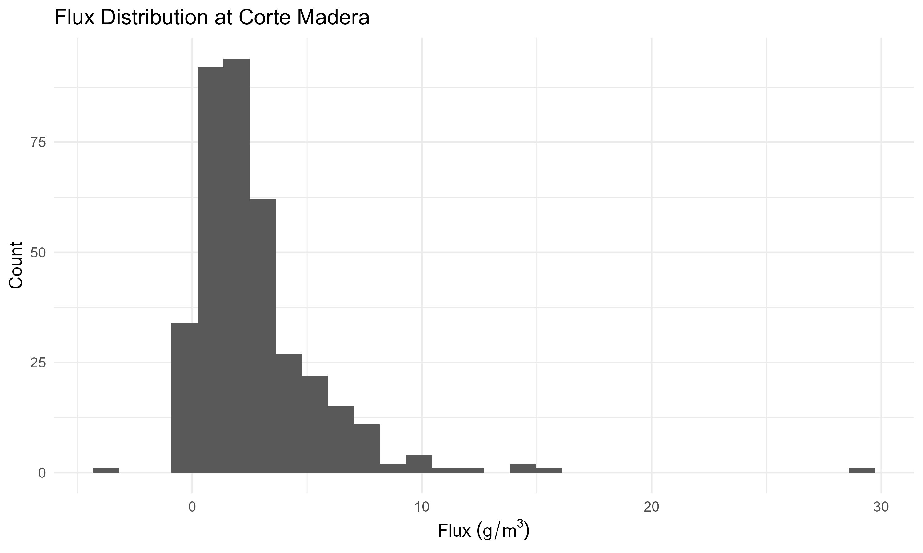
Notes:
Move the elevation to z* don’t use elevation! z* ties the comparison amongst sites. Distance from marsh edge should be first when explaining the data-marsh edge related question! Right skewed-normalized-can transfer the data and log. Interesting to share this for the distribution; use the skewness to adjust the GLMM; what’s driving the ambient lower values on the histogram, and what’s driving the higher flux values-are the high flux values dependent on edge type?!

Slide 8
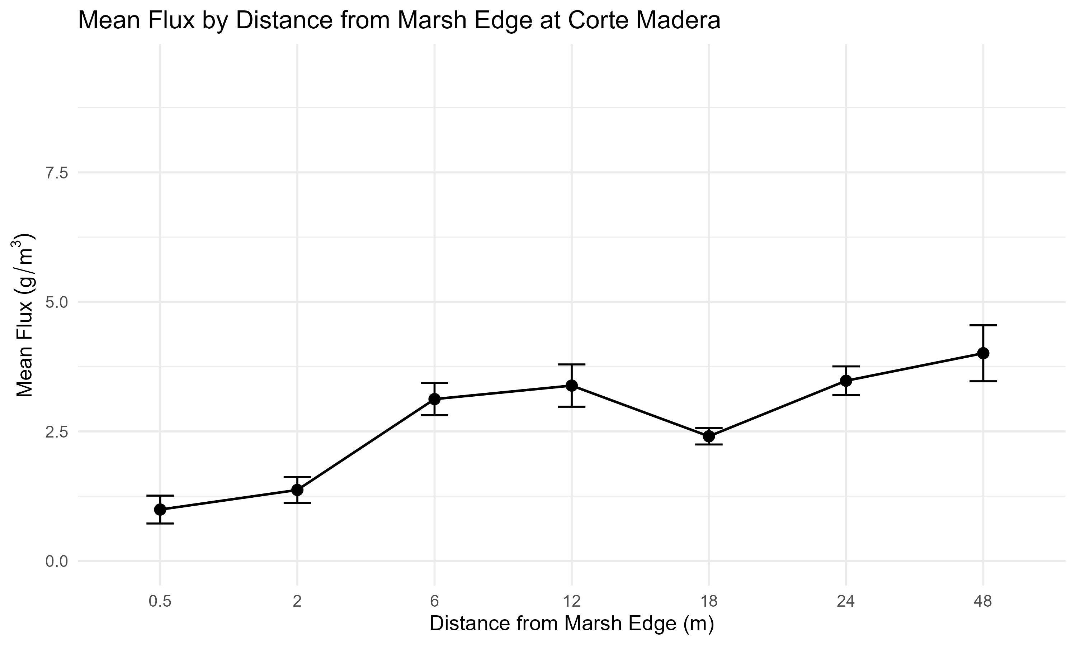
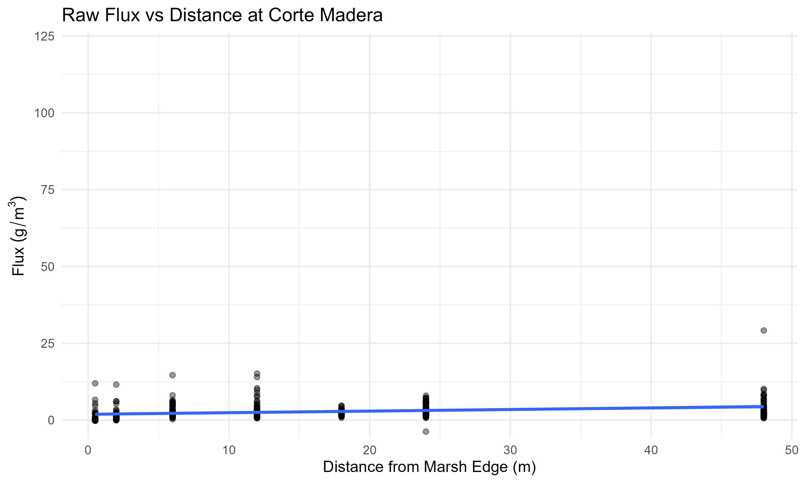
Distance From Marsh Edge-Mean and Raw Data
Notes:
Y axis has to have the time component!! g/m^2/day; volumetric measurement; change the y axis to be 25 on the graph on the left side; take out the line on the right side of the data-it doesn’t mean anything; marsh edge could erode the filters
How many time points have problems

Slide 9
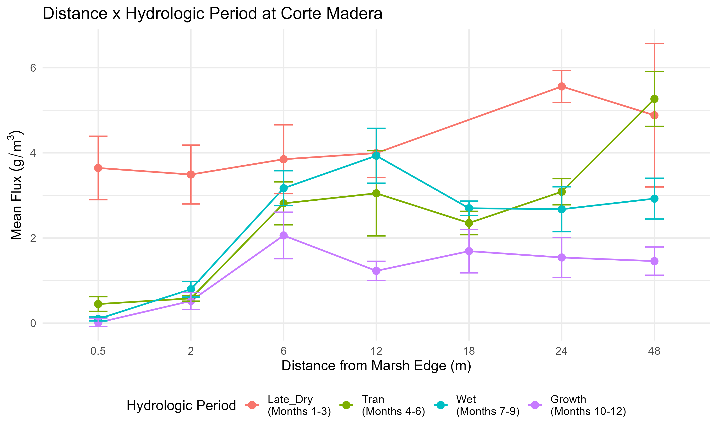
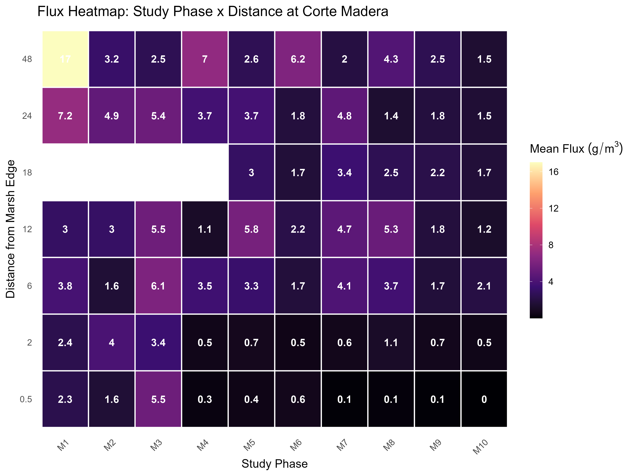
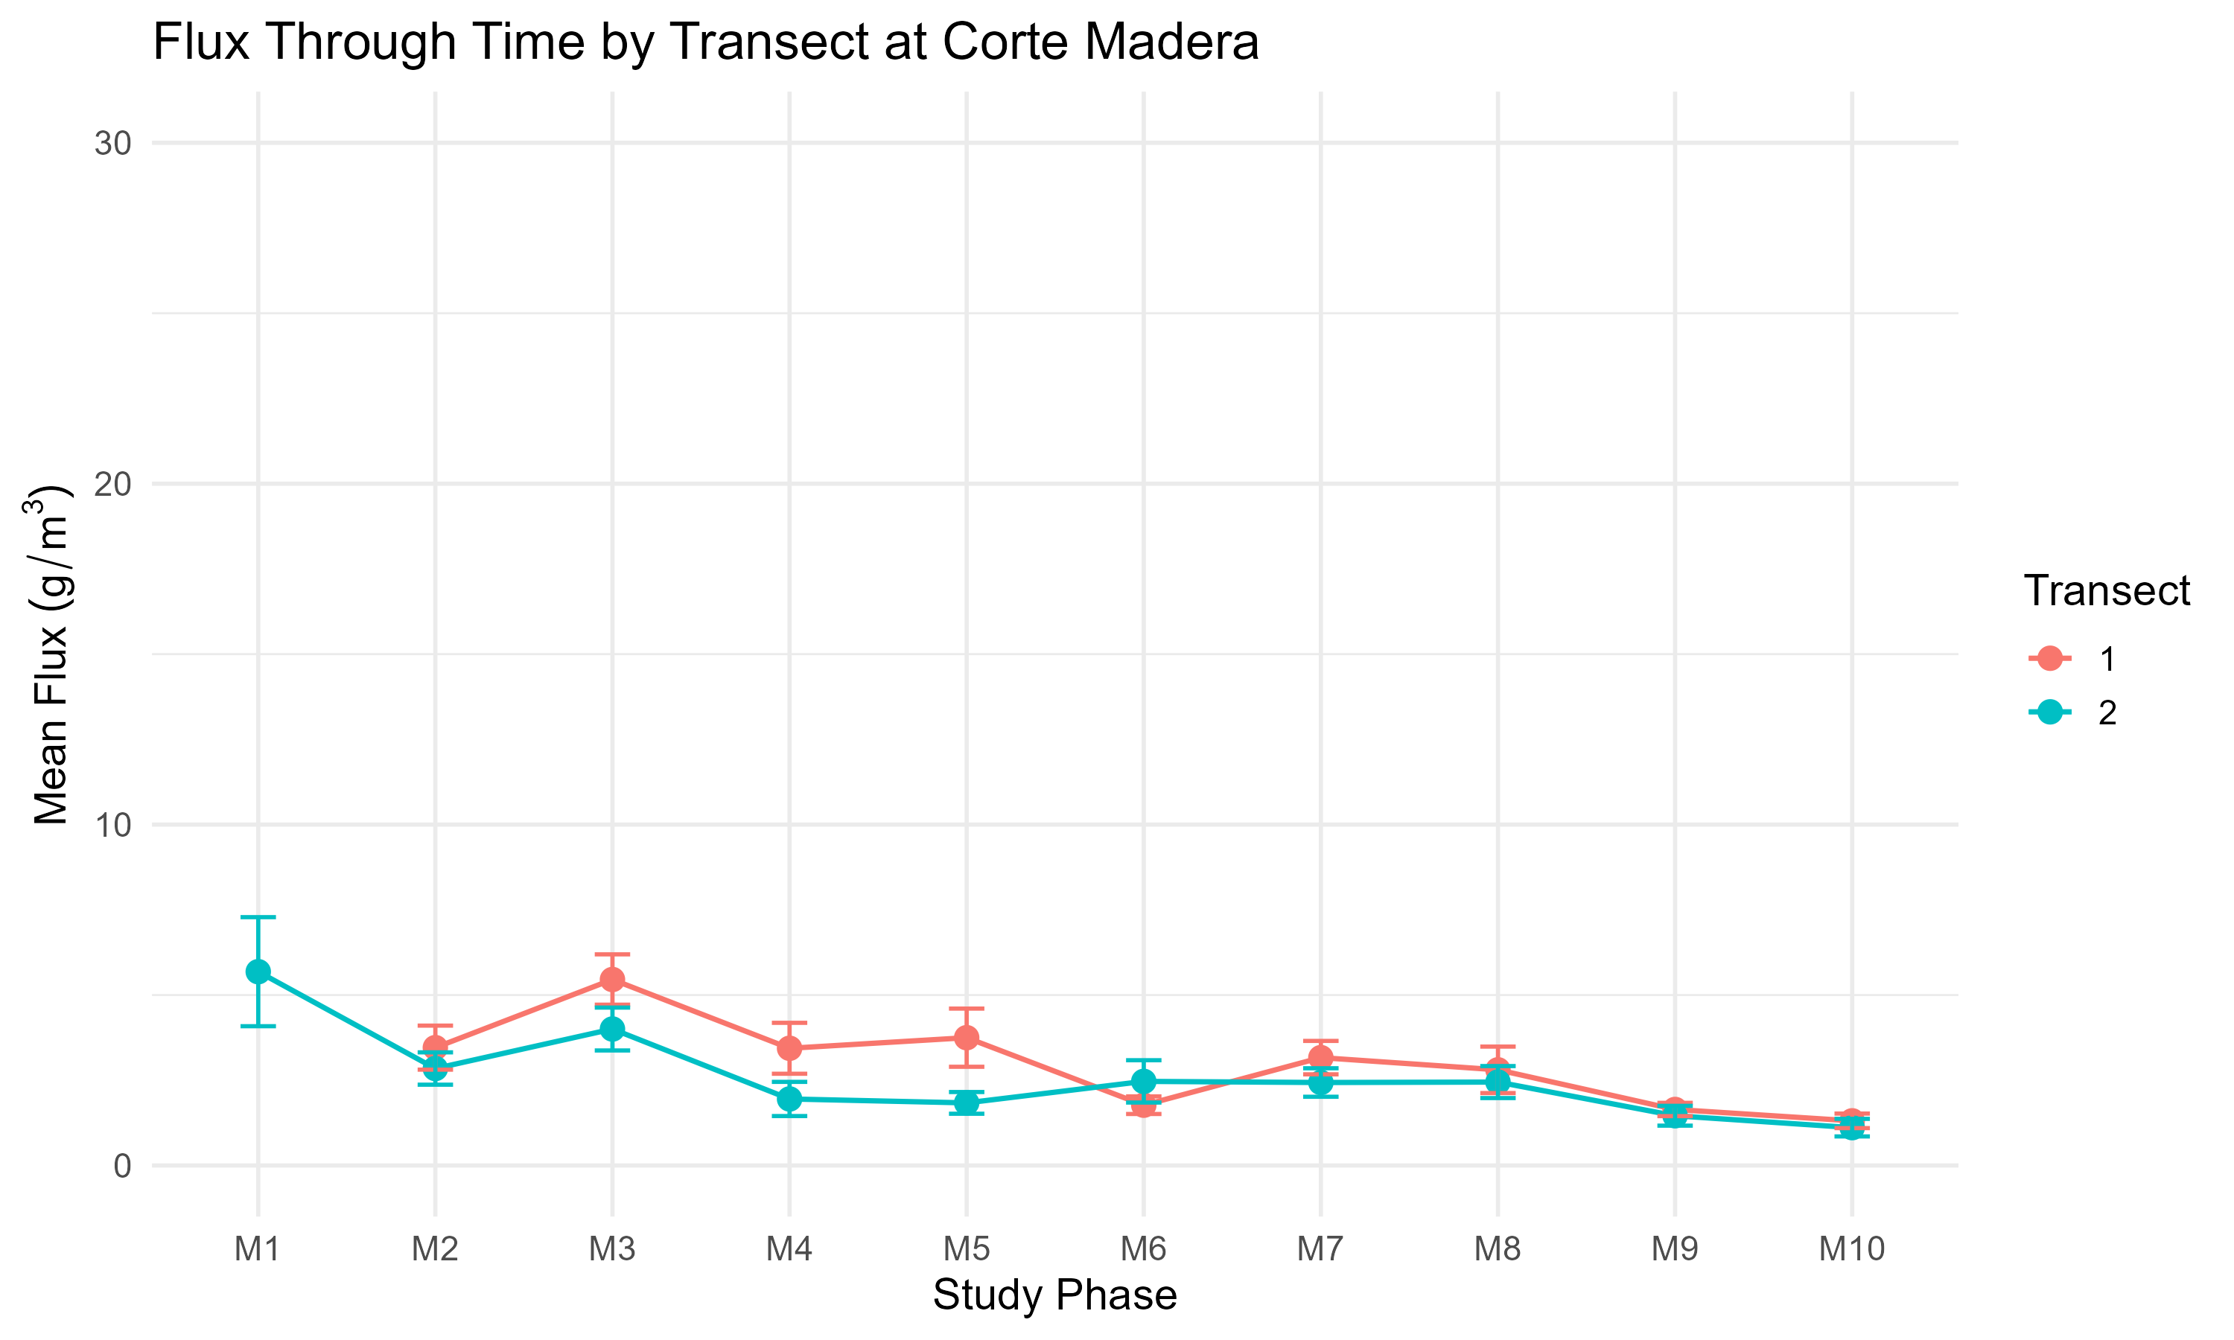
Distance and Location of Sediment Deposition Through Time
Notes:
Categorical representation for study phases misrepresents the site comparison values. Group the data coarsely to compare
Table for each of the sites document the problems for each of the sites with specific filter related issues. Tag the data for the problems so you can see the frequency and temporal differences. Conditional filter on the excel database that looks back on the other filters to get information

Slide 10
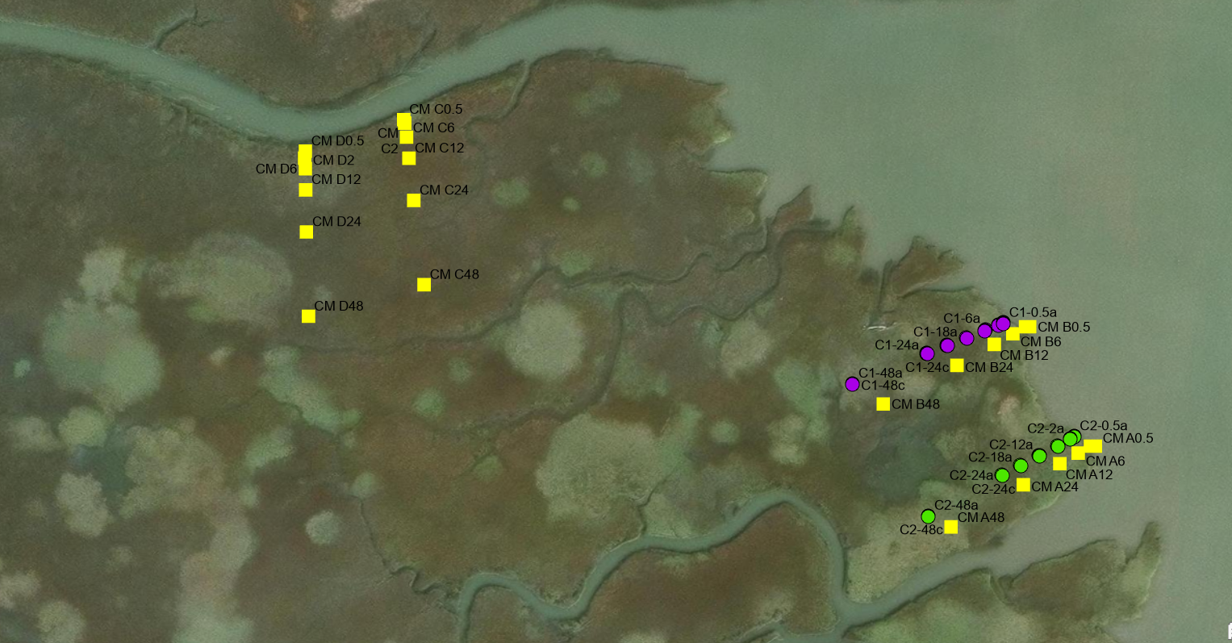

Slide 11
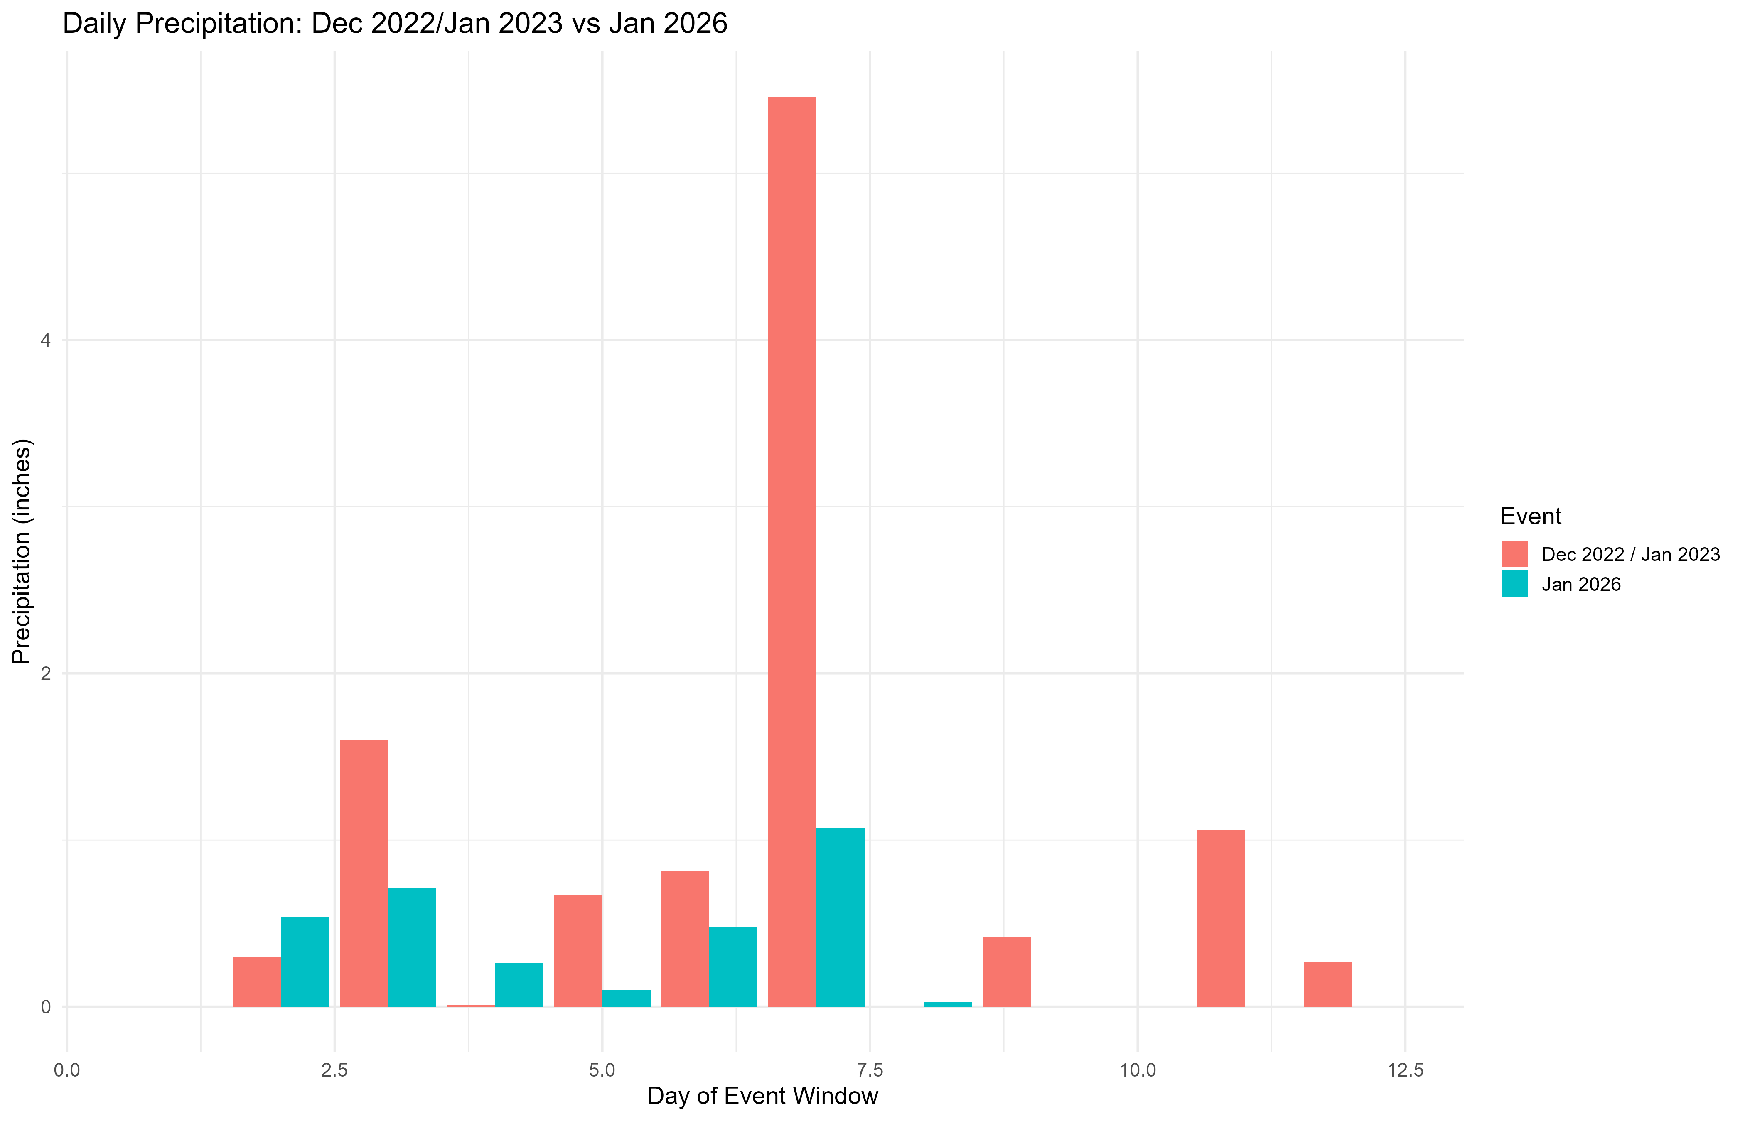
Precipitation Differences Across USGS and NERR Dataset!

Slide 12
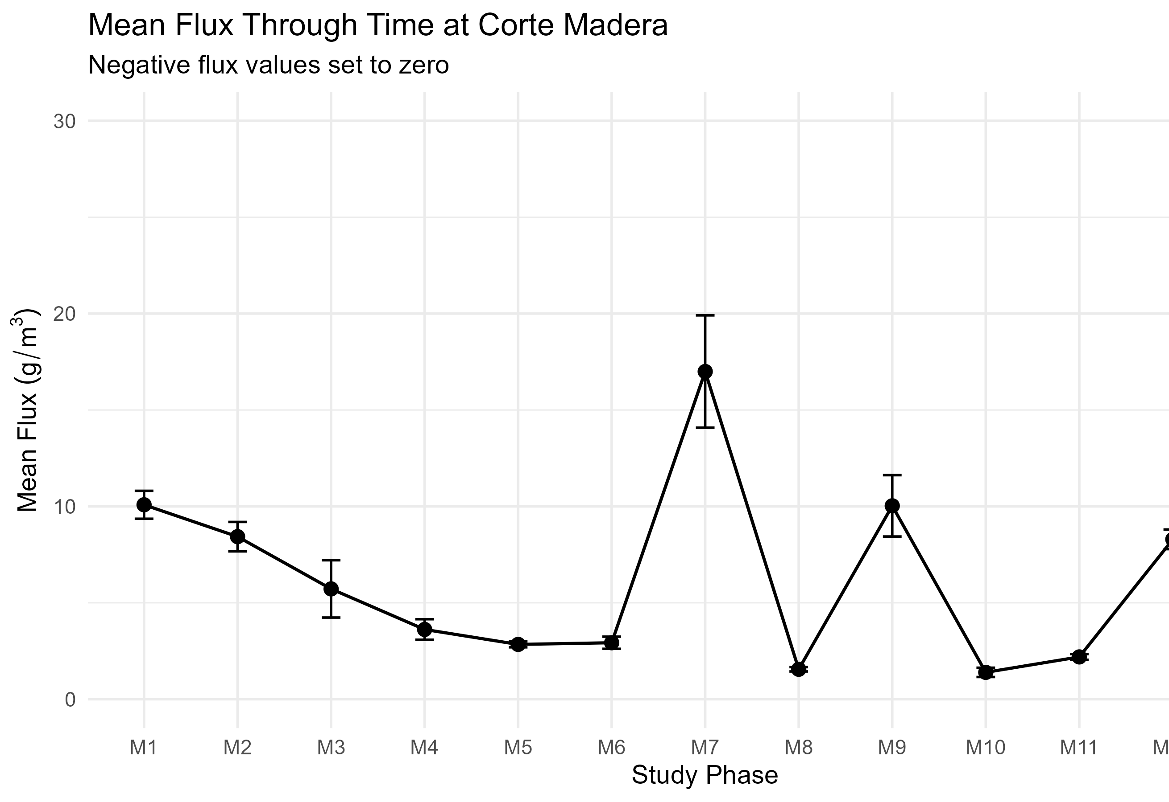
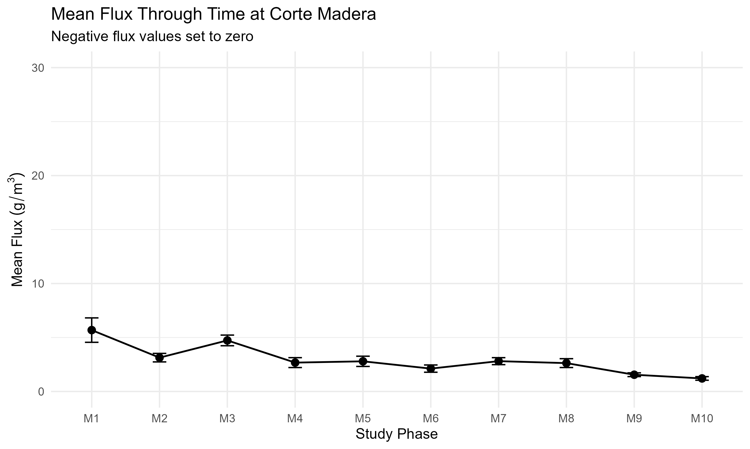
Look at the study areas and look at each 10 data points and see how much of the flags
2025-2026
2022-2023
Notes:
Do it per transect

